Slide 1

FASHION-MNIST CLASSIFICATION USING CNN

Slide 2
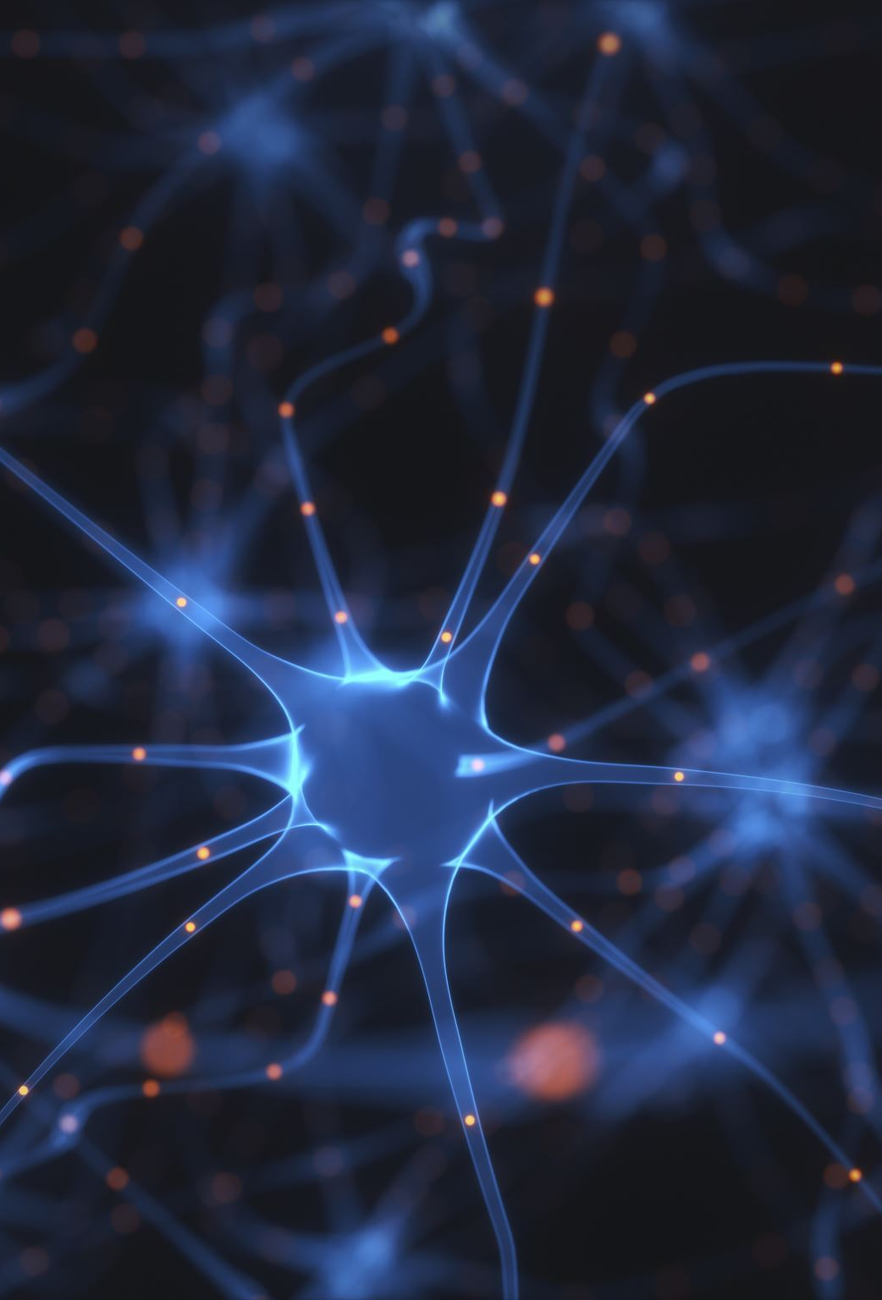
Agenda
Introduction
What is Image Classification?
Convolutional Neural Networks
Preprocessing of Image Data
Fashion-MNIST Dataset
How Model Work
How Project Work
Challenges and Limitations
Conclusion

Slide 3

Introduction
We live in a digital age where understanding and interpreting images is crucial.
Image classification is the task of teaching computers to recognize patterns, objects, or scenes in images.
Automated image classification has transformative potential, improving efficiency and safety.

Slide 4

What is Image Classification?
Image classification is the process of categorizing an image into one or more predefined classes or categories.
It is a fundamental problem in computer vision and has numerous applications in various fields such as healthcare, autonomous vehicles, and security systems.

Slide 5
What are Convolutional Neural Networks?
Convolutional Neural Networks (CNN) are a type of neural network that are particularly effective at image classification tasks.
They are inspired by the organization of the visual cortex in animals, and are designed to automatically learn and extract features from images.

Slide 6
Preprocessing of Image Data
The following steps are commonly used in data preprocessing for image classification:
Resizing images to a standard size to ensure consistency in input shape
Converting images to grayscale or RGB format based on the requirements of the model
Data augmentation techniques such as rotation, flipping, and zooming to increase the size of the training set and improve model performance
Normalization of pixel values to make them fall within a specific range, usually between 0 and 1

Slide 7
Fashion-MNIST Dataset
URL -
https://www.openml.org
Target Classes –
0 - T-shirt/top 5 - Sandal 1 - Trouser 6 - Shirt 2 - Pullover 7 - Sneaker 3 - Dress 8 - Bag 4 - Coat 9 - Ankle boot

Slide 8
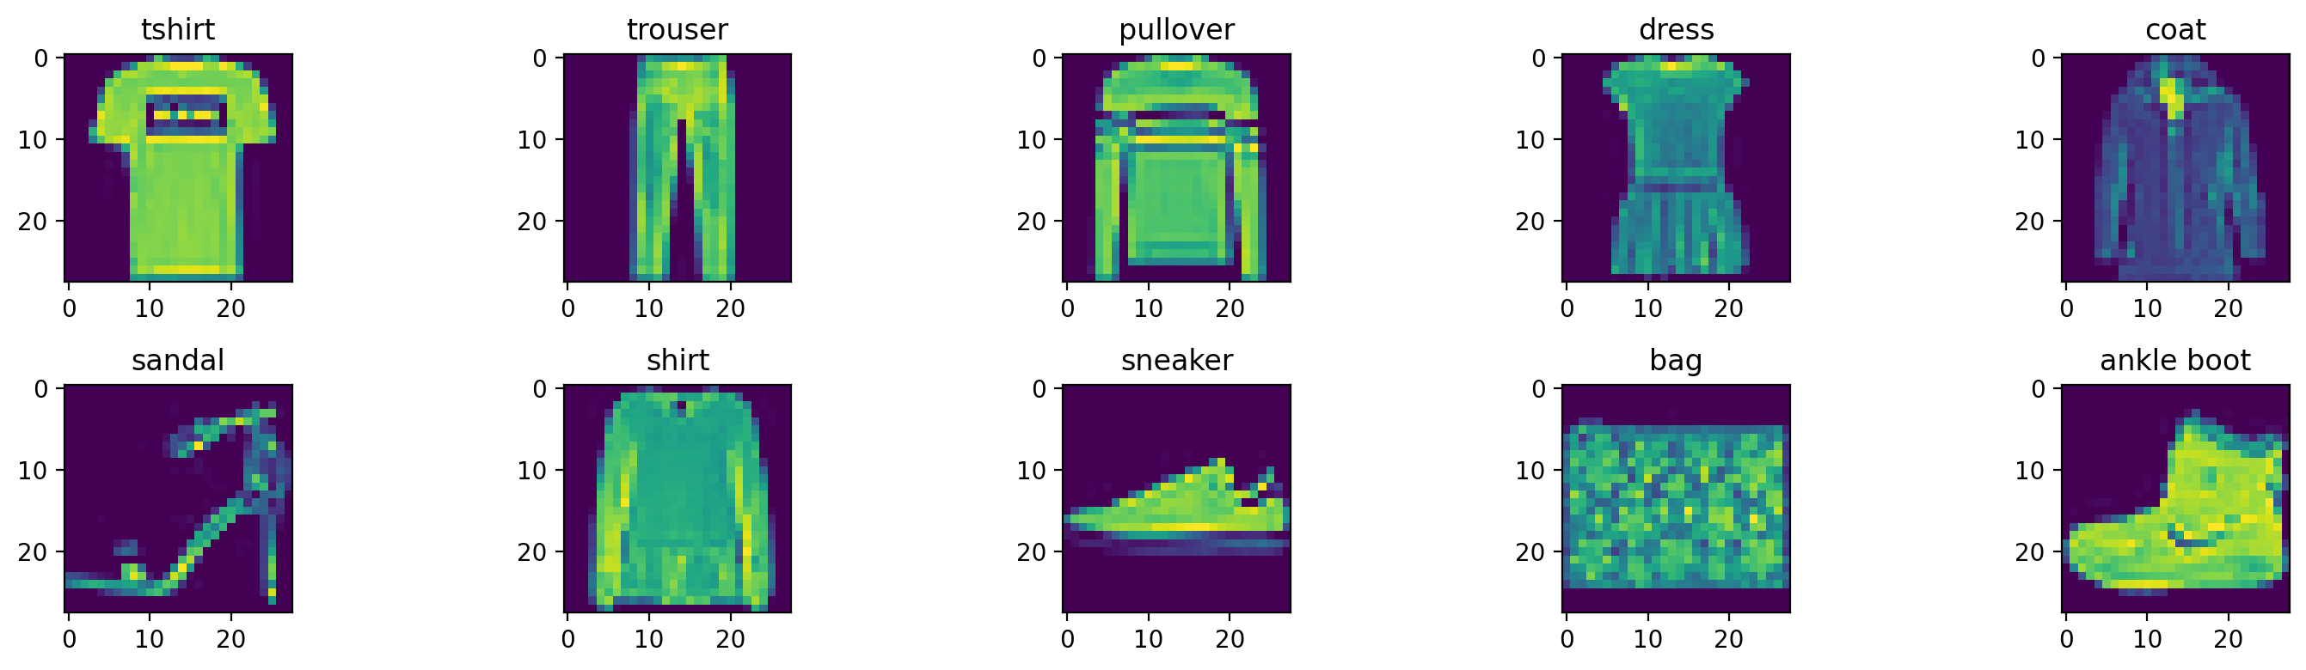
How model Work?

Slide 9
How model Work?
Fashion-MNIST is a dataset of Zalando's article images, consisting of a training set of 60,000 examples and a test set of 10,000 examples.
Each example is a 28x28 grayscale image, associated with a label from 10 classes.
Fashion-MNIST is intended to serve as a direct drop-in replacement for the original MNIST dataset for benchmarking machine learning algorithms. It shares the same image size and structure of training and testing splits.

Slide 10
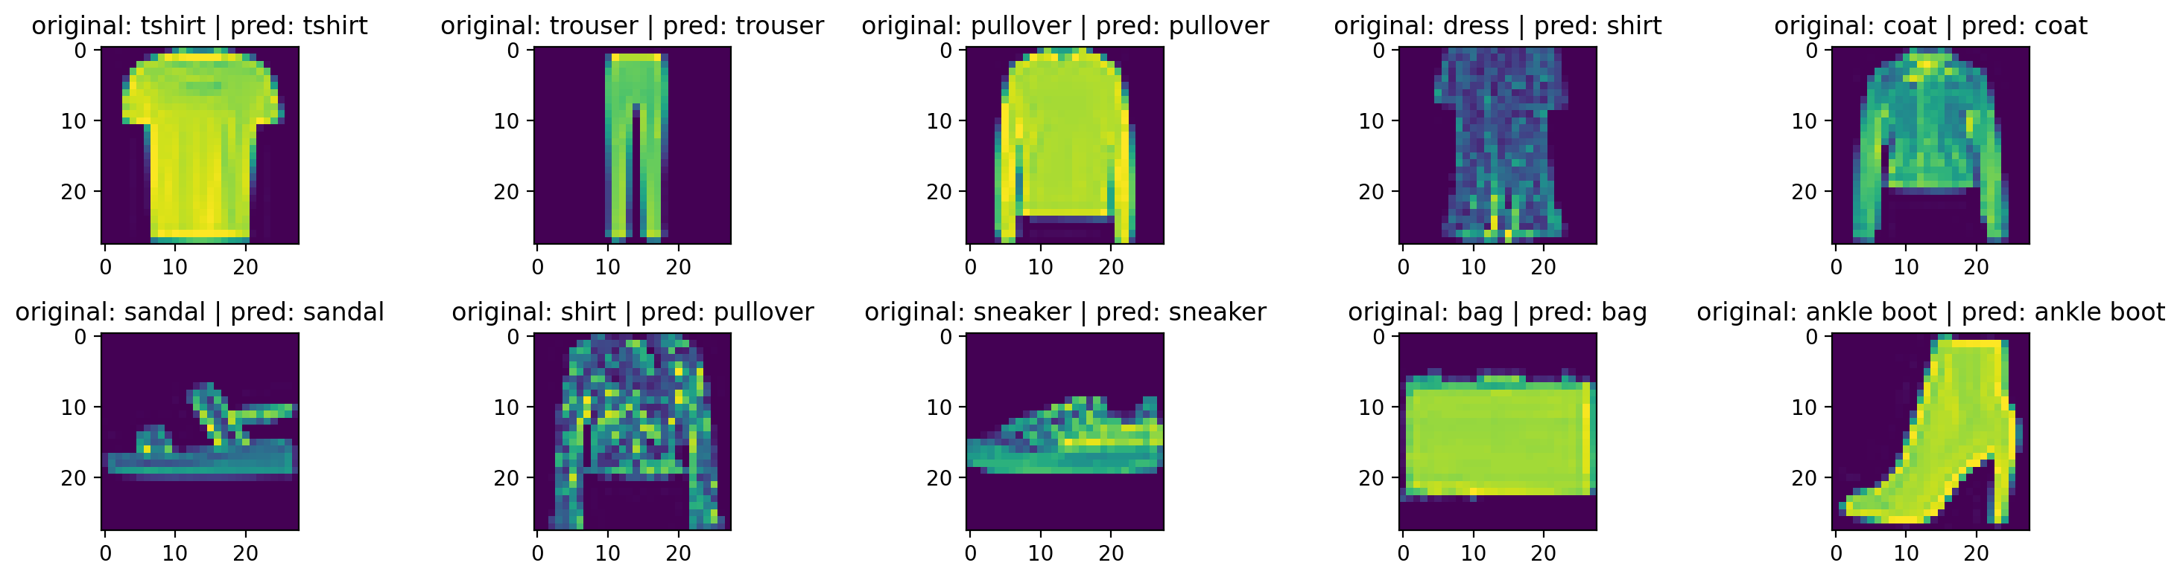
How Project Work?

Slide 11

Challenges and Limitations
Despite their effectiveness, CNNs still face several challenges and limitations.
They require large amounts of labeled training data to achieve high accuracy, which can be difficult and expensive to obtain.
Additionally, they may struggle with certain types of image classification tasks, such as identifying objects in cluttered or occluded scenes.

Slide 12
Conclusion
Summarize key points
CNNs are highly effective for image classification.
They excel in feature extraction through convolutional layers.
Popular architectures like VGG, ResNet, and Inception have enhanced performance.
Transfer learning is a practical approach for high accuracy.
Challenges include data size and resource requirements.
CNNs have wide applications in healthcare, autonomous vehicles, and more.

